Slide 1

EDA of CARDIOVASCULAR DISEASE
HAP618:FINAL PROJECT PRESENTATION
KRUTIKA DESHMUKH
GEORGE MASON UNIVERSITY

Slide 2


What is eda?
EXPLORATORY DATA ANALYSIS
Exploratory Data Analysis (EDA) is like being a detective for data. It's a crucial step in understanding the story our data wants to tell us. In the context of predicting cardiovascular disease (CVD), EDA involves digging into our dataset, asking questions, and finding trends or patterns that could be key to identifying factors associated with CVD risk.

Slide 3

Instead of jumping straight to predictions, EDA allows us to:
Understand the Data: What does our dataset look like? What kind of information does it hold?
Identify Relationships :Are certain factors connected to a higher risk of CVD? EDA helps
us explore relationships between different variables, like age, lifestyle, and medical
results.
Handle Missing Data : Sometimes, our data might be incomplete. EDA helps us figure
out how to deal with missing information, ensuring our predictions are as accurate as
possible.

Slide 4

KEY FACTS-
Cardiovascular diseases (CVDs) are the leading cause of death globally.
An estimated 17.9 million people died from CVDs in 2019, representing 32% of all global deaths. Of these deaths, 85% were due to heart attack and stroke.
Over three quarters of CVD deaths take place in low- and middle-income countries.
Out of the 17 million premature deaths (under the age of 70) due to noncommunicable diseases in 2019, 38% were caused by CVDs.
Most cardiovascular diseases can be prevented by addressing behavioural risk factors such as tobacco use, unhealthy diet and obesity, physical inactivity and harmful use of alcohol.
It is important to detect cardiovascular disease as early as possible so that management with counselling and medicines can begin.

Slide 5
WHAT ARE CARDIOVASCULAR DISEASES?
Cardiovascular diseases (CVDs) are a group of disorders of the heart and blood vessels. They include:
Coronary heart disease – a disease of the blood vessels supplying the heart muscle;
Cerebrovascular disease – a disease of the blood vessels supplying the brain;
Peripheral arterial disease – a disease of blood vessels supplying the arms and legs;
Rheumatic heart disease – damage to the heart muscle and heart valves from rheumatic fever, caused by streptococcal bacteria;
Congenital heart disease – birth defects that affect the normal development and functioning of the heart caused by malformations of the heart structure from birth; and
Deep vein thrombosis and pulmonary embolism – blood clots in the leg veins, which can dislodge and move to the heart and lungs.

Slide 6
INTRODUCTION
Heart problems are a big health issue around the world, causing a lot of sickness and death. To tackle this, we want to use data to figure out the things that make heart problems more likely, see the patterns in the information, and find ways to stop them before they happen. Our project is all about exploring the data we have, like going on a journey through a treasure trove of information, to understand why heart problems happen and find clues to prevent them. We're looking for hidden details in the data that can tell us why heart problems are common and how we can stop them from affecting people.

Slide 7
DATA DESCRIPTION
FEATURES-
Age | Objective Feature | age | int (days)
Height | Objective Feature | height | int (cm) |
Weight | Objective Feature | weight | float (kg) |
Systolic blood pressure | Examination Feature | ap_hi | int |
Diastolic blood pressure | Examination Feature | ap_lo | int |
Cholesterol | Examination Feature | cholesterol | 1: normal, 2: high, 3: very high
Physical activity | Subjective Feature | active | binary |
Presence or absence of cardiovascular disease | Target Variable | cardio | binary |

Slide 8
Tools and libraries USED FOR THIS PROJECT
TOOLS - Python
PLATFORM - Collab
LIBRARIES-
Numpy - I have used Numpy for the Numerical Computing
Pandas: I have used pandas for Data Manipulation and Analysis
Matplotlib– Used for 2D plotting Library. Key features are line plots, Scatter plots, Customization
Seaborn- sed for Statistical Data visualization. Key features of the seaborn are High level Interface , Specialized plots, Stylistic enhancements.
.

Slide 9
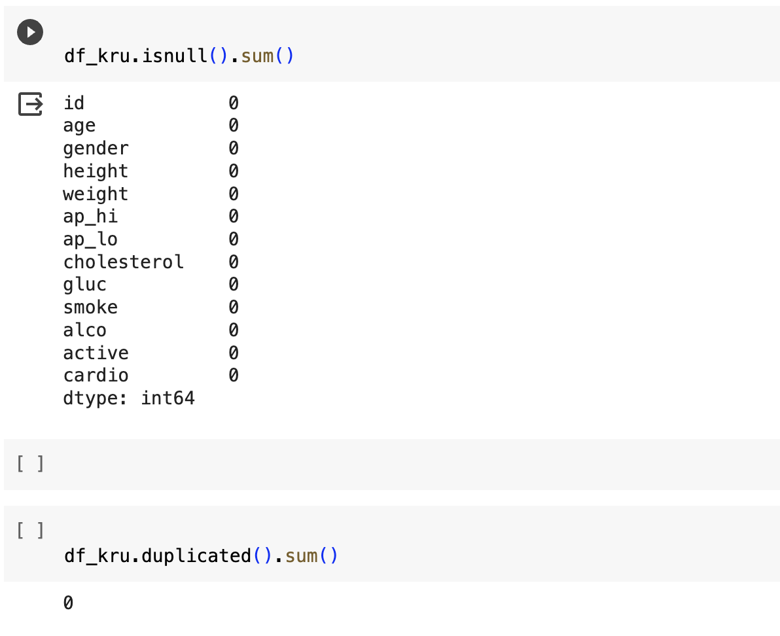
DATA preprocessing
Dataset loading :There are 70000 entries of patient records.
Missing values:From this we can assume that there is 0 Null values in the dataset
Duplicate values: There are 0 duplicate values in the dataset.
From this data cleaning process we can conclude that the dataset is good to go for analysing

Slide 10
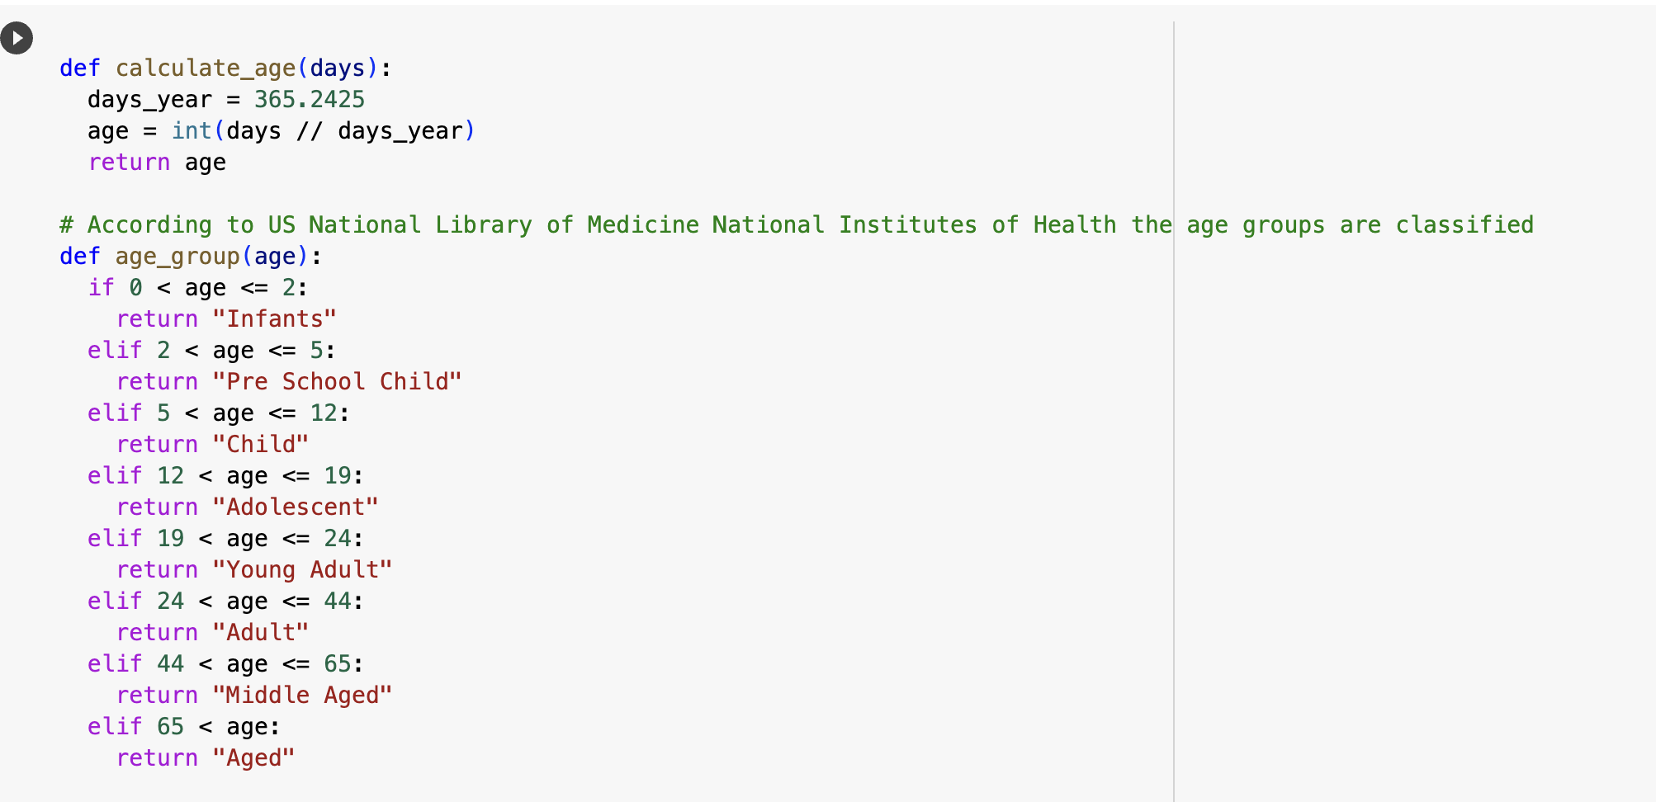
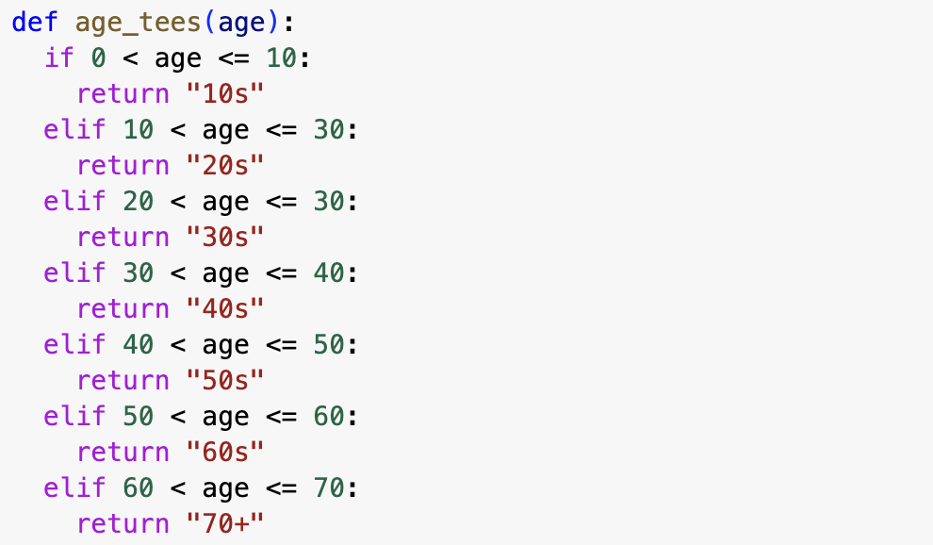
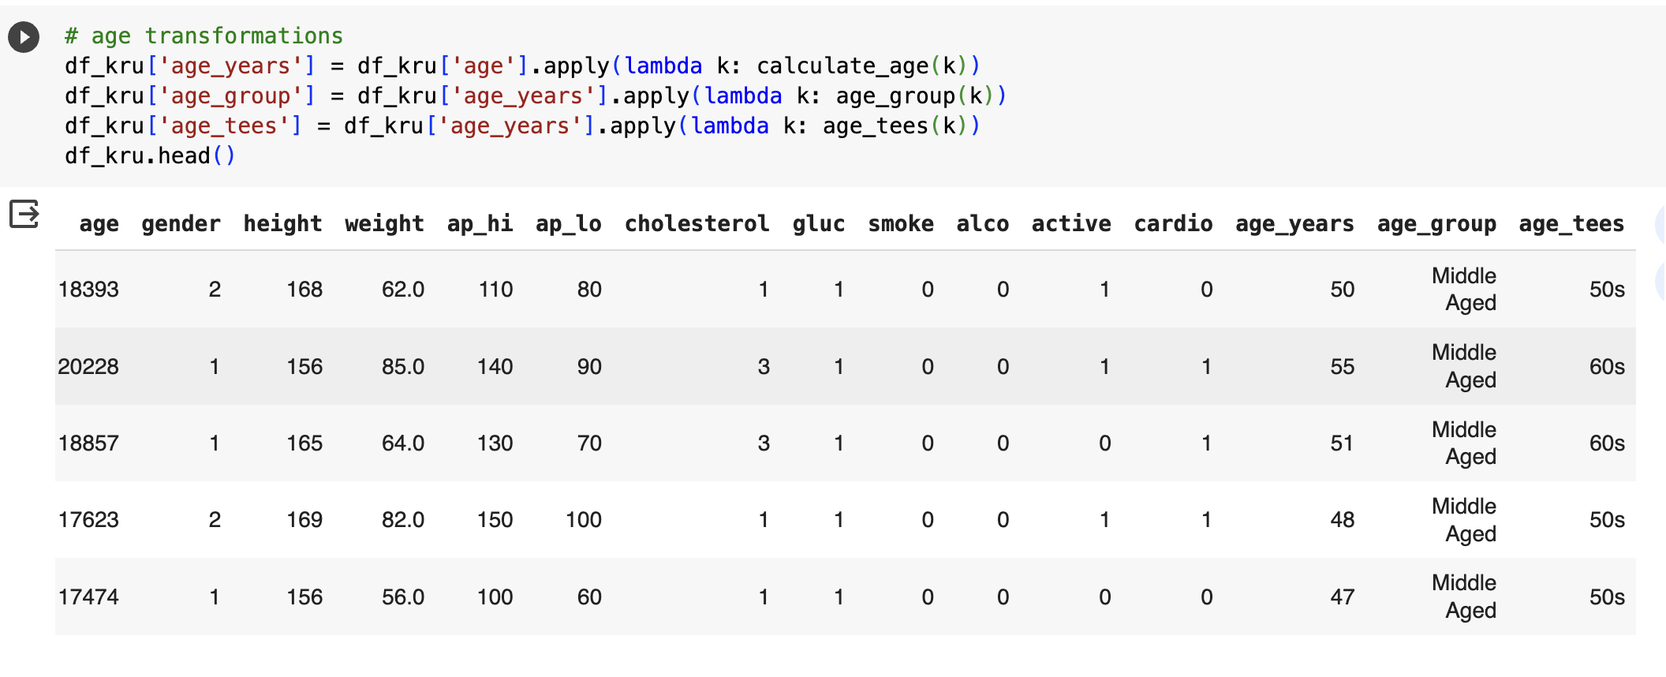

Slide 11
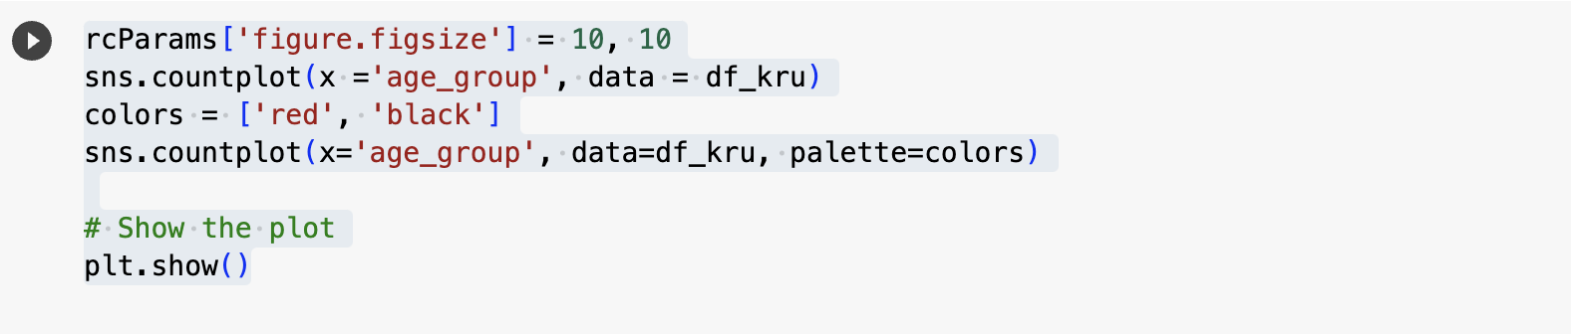
AGE_GROUP VISUALIZATION
rcParams['figure.figsize'] = 10, 10: This line sets the figure size for the upcoming plot to 10 inches by 10 inches
sns.countplot(x ='age_group', data = df_kru): This uses Seaborn's countplot function to create a bar plot. It visualizes the distribution of data in the DataFrame df_kru based on the 'age_group' column

Slide 12
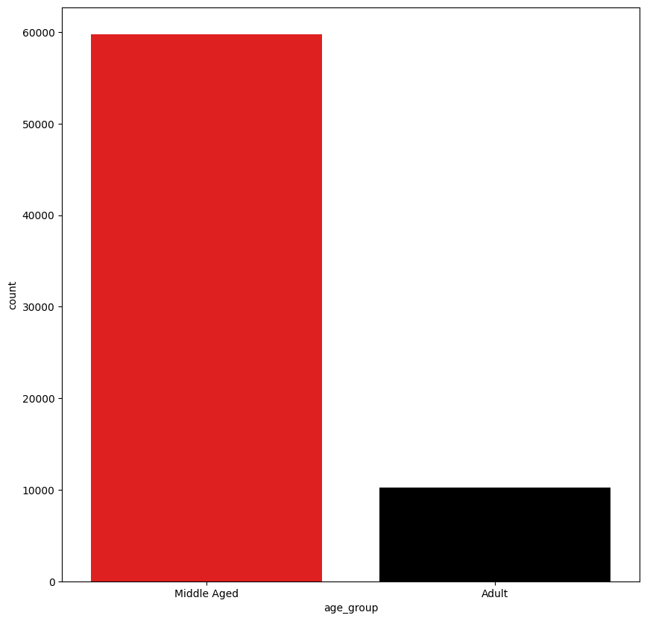
AGE GROUP VISUALIZATION
The above code and its visual representation shows that the dataset contains majorly middle age people and minor adult data.

Slide 13
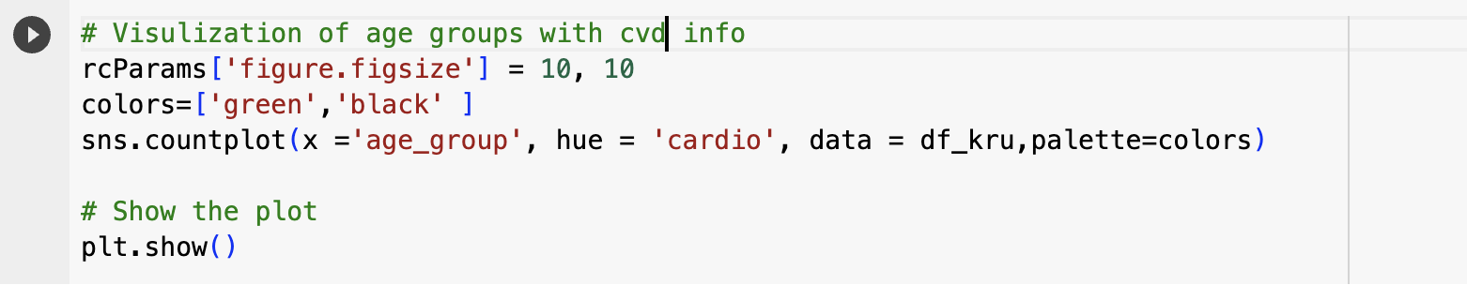
rcParams['figure.figsize'] = 10, 10: Sets the size of the figure for the plot to be 10 inches by 10 inches using Matplotlib's rcParams.
colors=['green','black']: Defines a custom color palette with 'green' for one category and 'black' for another.
sns.countplot(x='age_group', hue='cardio', data=df_kru, palette=colors): Creates a count plot using Seaborn. The x-axis represents different age groups, and the plot is differentiated by the presence or absence of cardiovascular disease (cardio column) using the hue parameter. Each age group has bars representing the count of occurrences, with different colors for the two 'cardio' categories.

Slide 14
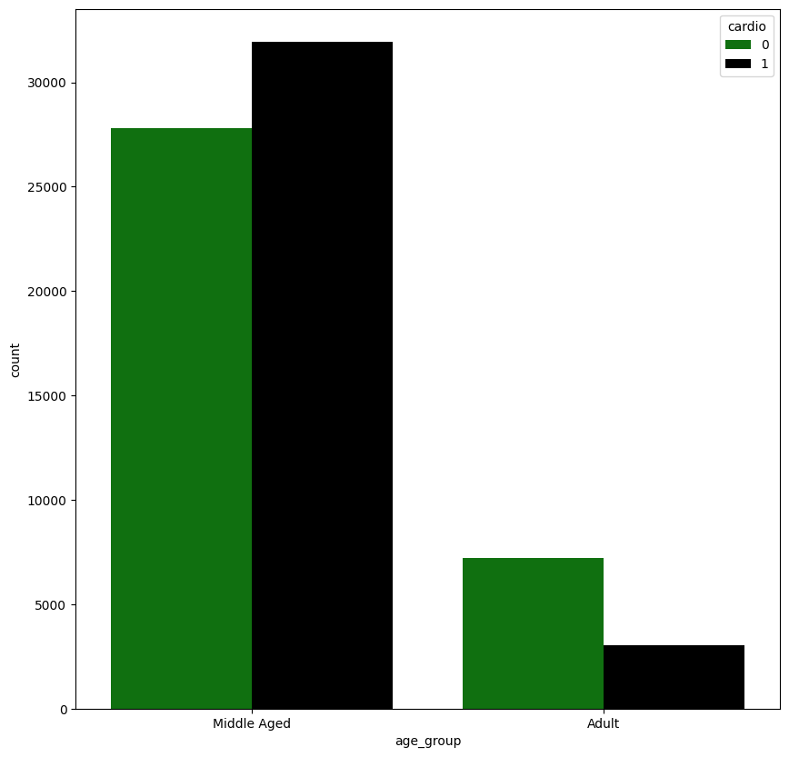
The resulting visualization is a clustered bar chart where each age group is divided into two bars (green and black) representing the counts of individuals with and without cardiovascular disease. The x-axis represents the age groups, and the y-axis represents the count of occurrences. This plot allows for a quick comparison of the distribution of cardiovascular disease within each age group
The graph indicates that middle aged groups are mostly affected by Cardio Vascular Disease when compared to adult.

Slide 15
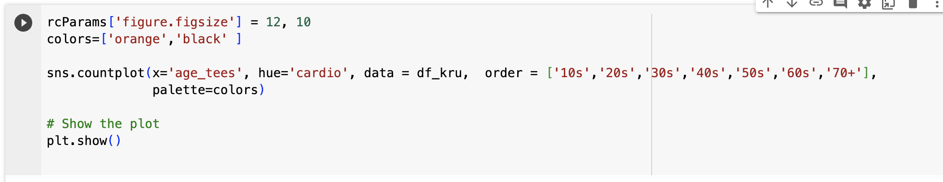
Visualization for age_tees and cvd
rcParams['figure.figsize'] = 12, 10: Sets the size of the figure for the plot to be 12 inches by 10 inches using Matplotlib's rcParams.
colors=['orange','black']: Defines a custom color palette with 'orange' for one category and 'black' for another.
sns.countplot(x='age_tees', hue='cardio', data=df_kru, order=['10s', '20s', '30s', '40s', '50s', '60s', '70+'], palette=colors): Creates a count plot using Seaborn. The x-axis represents different age groups (age_tees), and the plot is differentiated by the presence or absence of cardiovascular disease (cardio) using the hue parameter. The order parameter specifies the order of age groups on the x-axis.
plt.show(): Displays the count plot using Matplotlib

Slide 16
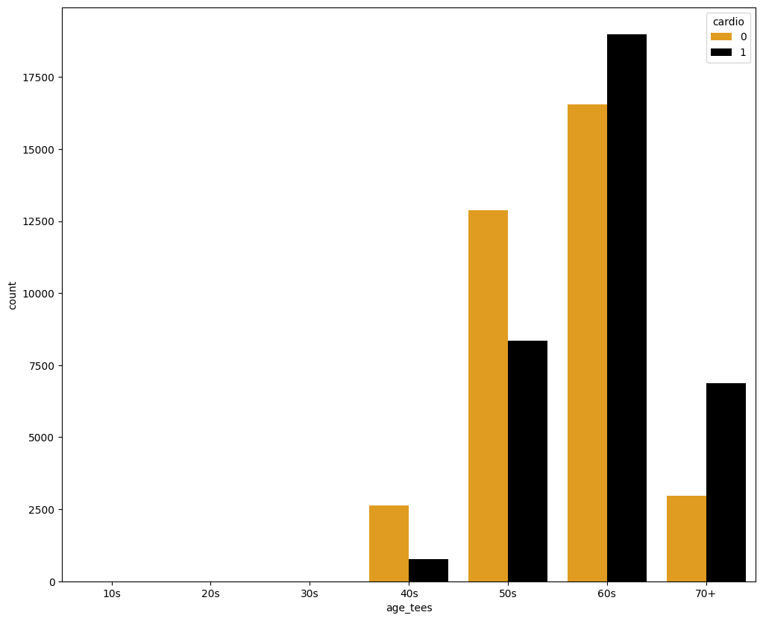
The resulting visualization is a clustered bar chart where each age group is divided into two bars (orange and black) representing the counts of individuals with and without cardiovascular disease. The x-axis represents the age groups in the specified order, and the y-axis represents the count of occurrences
The graph indicates that 60 s and 70 + are mostly affected by Cardiovascular Disease .

Slide 17
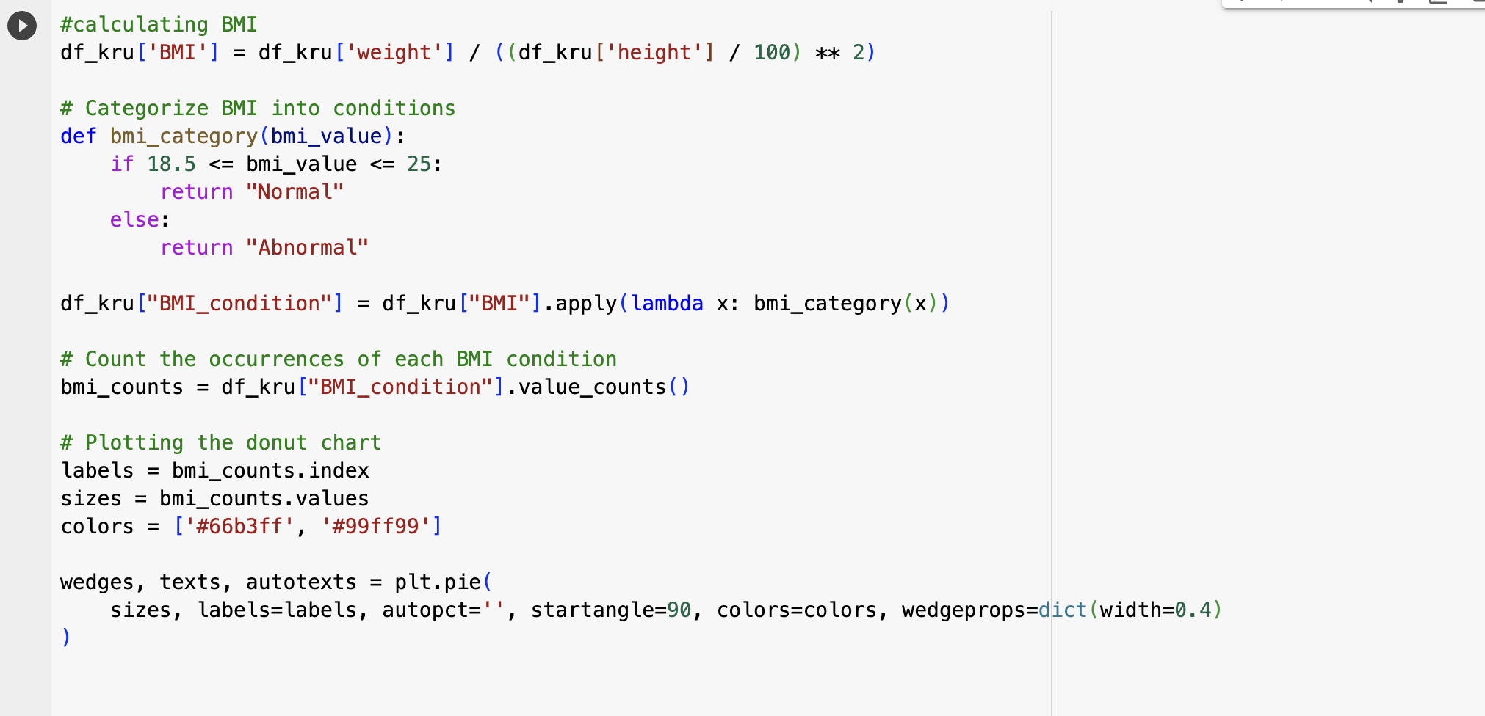
VISUALIZATION OF BMI
The code calculates BMI (Body Mass Index) for a DataFrame df_kru using weight and height columns
This code creates a donut chart using Matplotlib's plt.pie. The chart visualizes the sizes of different categories (given by sizes) with corresponding labels (labels). The colors for each category are specified by colors. The donut effect is achieved by setting the width of the wedges using wedgeprops=dict(width=0.4). The chart has a start angle of 90 degrees, and autopct='' ensures that percentage labels are not displayed.

Slide 18
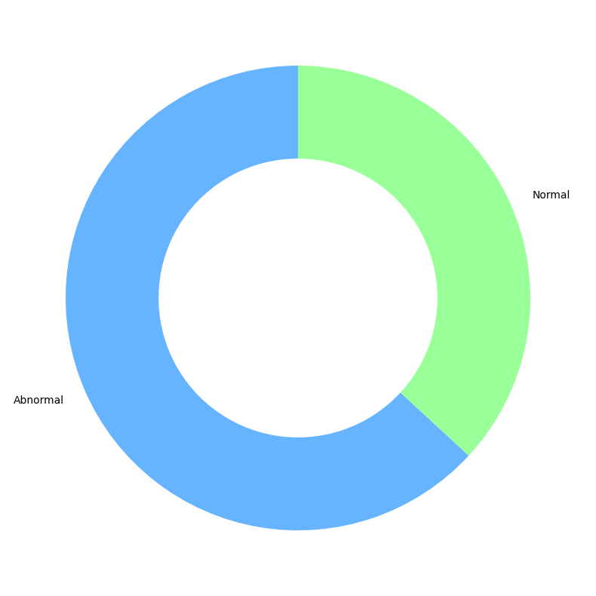
DONUT CHART FOR BMI
The resulting donut chart displays the distribution of BMI conditions, distinguishing between "Normal" and "Abnormal" categories. The chart provides a visual summary of how many individuals fall into each BMI condition, with the colors representing different conditions.

Slide 19
VISUALIZATION FOR BMI AND CVD
rcParams['figure.figsize'] = 10, 10: Sets the size of the figure for the plot to be 10 inches by 10 inches using Matplotlib's rcParams.
sns.countplot(x='BMI_condition', hue='cardio', data=df_kru, palette="Paired"): Creates a count plot using Seaborn. The x-axis represents different BMI conditions (BMI_condition), and the plot is differentiated by the presence or absence of cardiovascular disease (cardio) using the hue parameter. The color palette "Paired" is specified, which provides distinct colors for each combination of BMI condition and cardio status

Slide 20
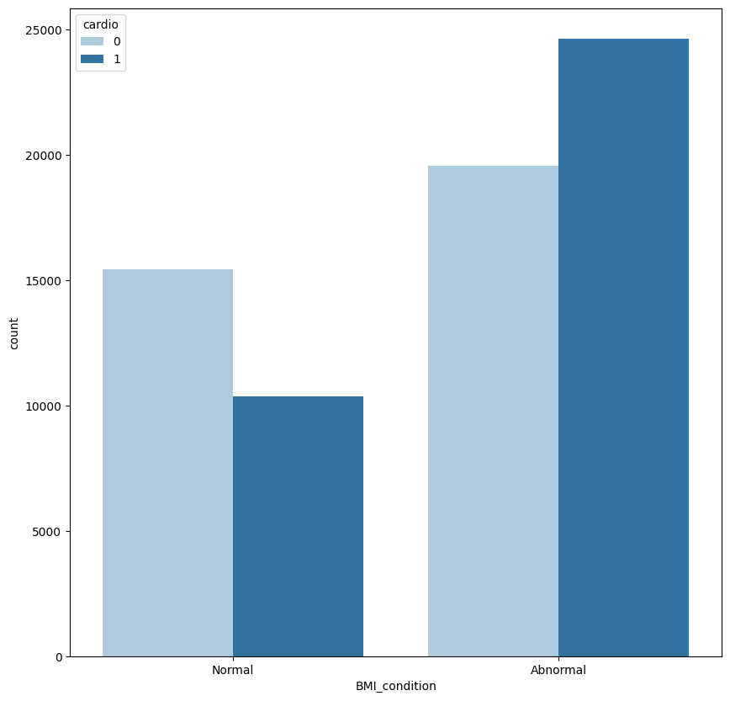
The resulting plot illustrates the counts of individuals with and without cardiovascular disease for each BMI condition

Slide 21
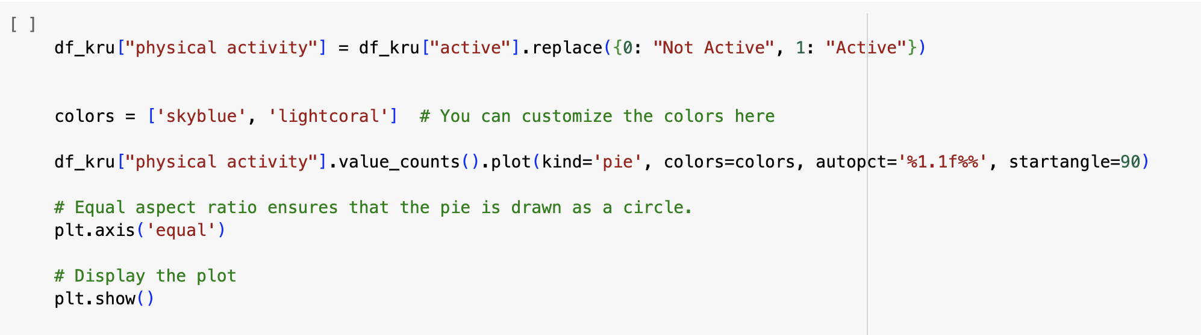
VISUALIZATION FOR PHYSICAL ACTIVITY
df_kru["physical activity"] = df_kru["active"].replace({0: "Not Active", 1: "Active"}): Creates a new column "physical activity" in the DataFrame df_kru, replacing 0 with "Not Active" and 1 with "Active" based on the values in the existing "active" column.
colors = ['skyblue', 'lightcoral']: Defines custom colors for the pie chart.
df_kru["physical activity"].value_counts().plot(kind='pie', colors=colors, autopct='%1.1f%%', startangle=90): Generates a pie chart representing the distribution of values in the "physical activity" column. The colors parameter specifies the color palette, autopct='%1.1f%%' displays percentage labels, and startangle=90 rotates the chart to start from the top.
plt.axis('equal'): Ensures an equal aspect ratio for a circular pie chart.
plt.show(): Displays the pie chart

Slide 22
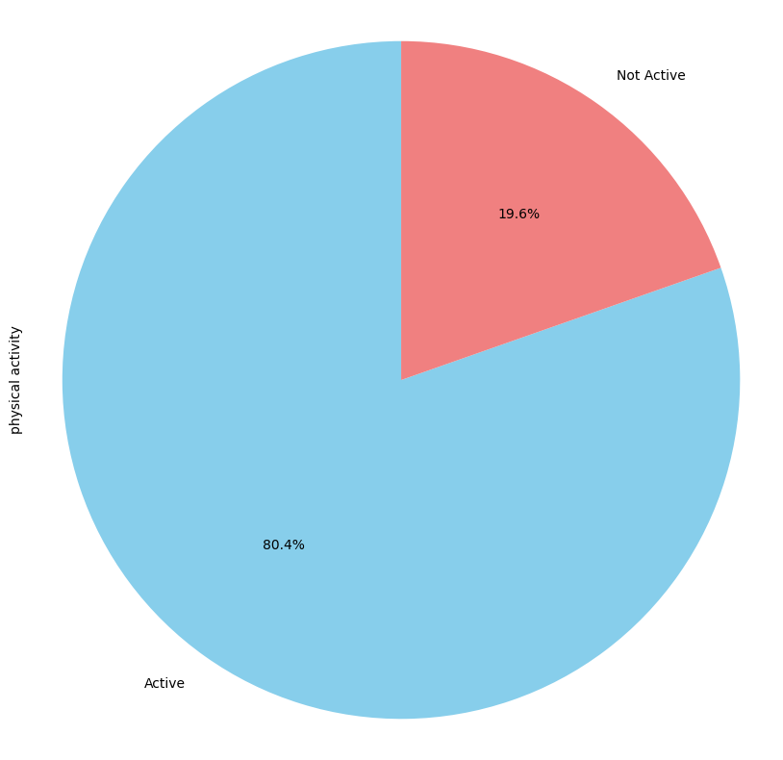
The resulting pie chart visually represents the percentage distribution of "Not Active" and "Active" categories in the "physical activity" column. Each segment of the pie corresponds to one category, and the percentage labels indicate the proportion of individuals in each activity status

Slide 23
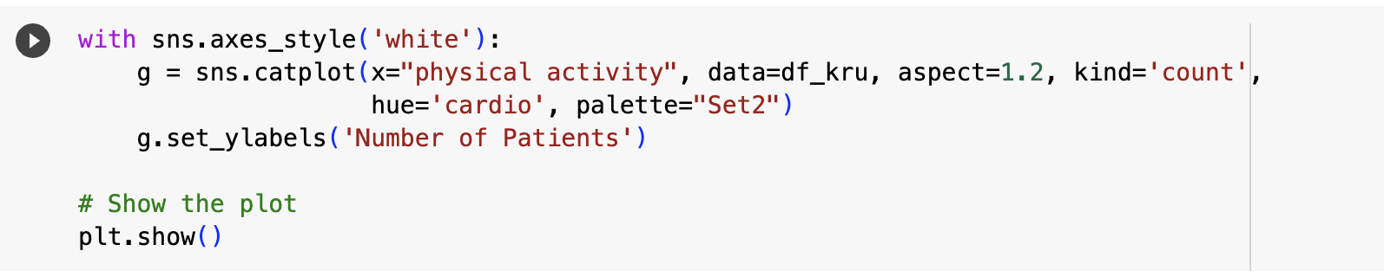
Visualization for physical activity and cvd
with sns.axes_style('white'):: This line uses Seaborn's context manager to temporarily set the plotting style to 'white
g = sns.catplot(x="physical activity", data=df_kru, aspect=1.2, kind='count', hue='cardio', palette="Set2"): This line creates a categorical plot (catplot) using Seaborn. It visualizes the distribution of data in the DataFrame df_kru based on the 'physical activity' column. The plot type is set to 'count,' and it is categorized by the 'cardio' column. The aspect ratio is set to 1.2 for improved proportions, and the color palette is specified as "Set2.

Slide 24
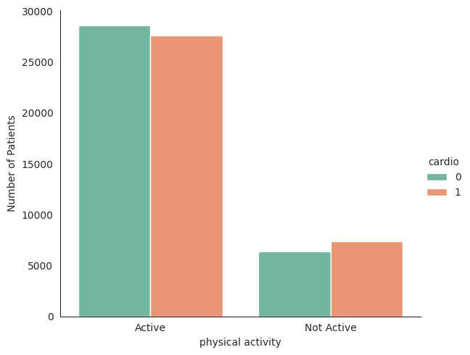
The plot shows two bars for each physical activity category, distinguished by the "cardio" variable's hue. Different colors represent the presence or absence of cardiovascular disease.
The y-axis indicates the number of patients in each category

Slide 25
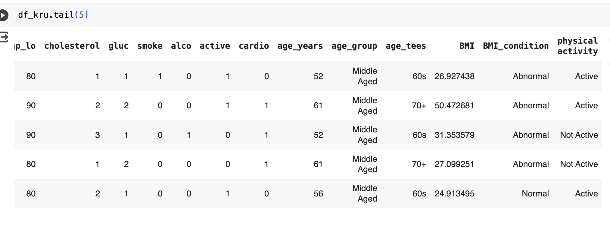

Slide 26
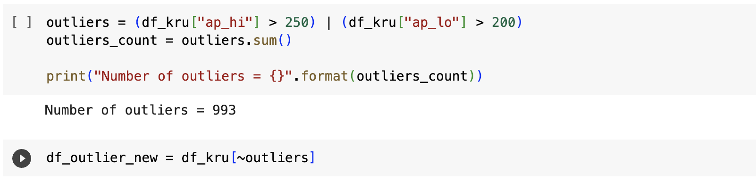
OUTLIERS

Slide 27

VISUALIZATION OF DISTRIBUTION OF SYSTOLIC BLOOD PRESSURE
sns.violinplot(y=df_outlier_new["ap_hi"]): Generates a violin plot using Seaborn. The 'ap_hi' column values from the DataFrame df_outlier_new are represented on the y-axis. A violin plot displays the distribution of the data, providing insights into its shape, spread, and central tendency.
plt.title("Distribution of Systolic Blood Pressure"): Adds a title to the plot, specifying that the visual representation is illustrating the distribution of systolic blood pressure.
plt.show(): Displays the plot.

Slide 28
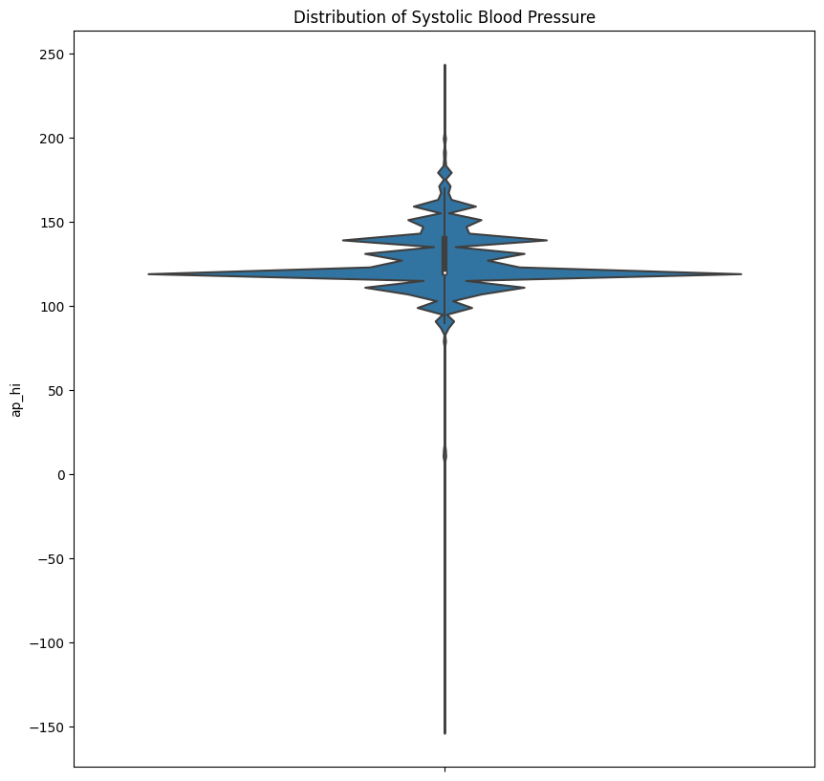
The resulting violin plot illustrates the distribution of systolic blood pressure. The plot includes a mirrored kernel density estimation on each side, offering a view of the data's probability density at different values. This type of plot is particularly useful for visualizing the shape and distribution of a dataset, including the presence of multiple modes or unusual patterns.

Slide 29
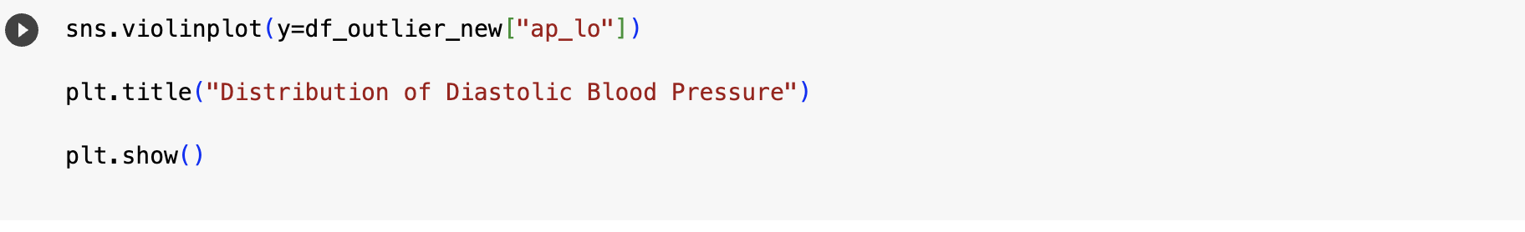
VISUALIZATION OF DISTRIBUTION OF DIASTOLIC BLOOD PRESSURE
sns.violinplot(y=df_outlier_new["ap_lo"]): Generates a violin plot using Seaborn. The 'ap_lo' column values from the DataFrame df_outlier_new are represented on the y-axis. Similar to the previous explanation, a violin plot provides insights into the distribution of data, including its shape and central tendency.
plt.title("Distribution of Diastolic Blood Pressure"): Adds a title to the plot, indicating that the visual representation is illustrating the distribution of diastolic blood pressure.
plt.show(): Displays the plot

Slide 30
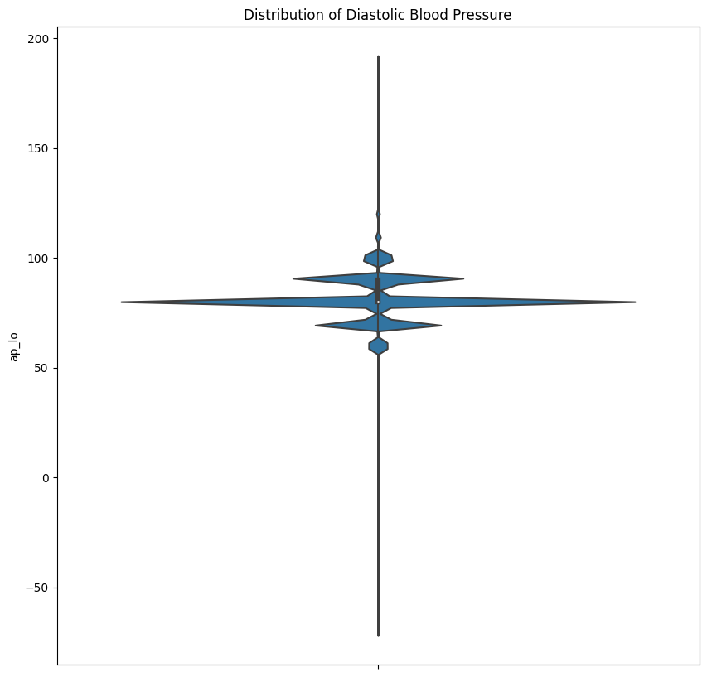
The resulting violin plot visually represents the distribution of diastolic blood pressure. The plot includes mirrored kernel density estimation on each side, offering insights into the probability density at different values. This type of plot helps in understanding the spread and shape of the diastolic blood pressure data

Slide 31
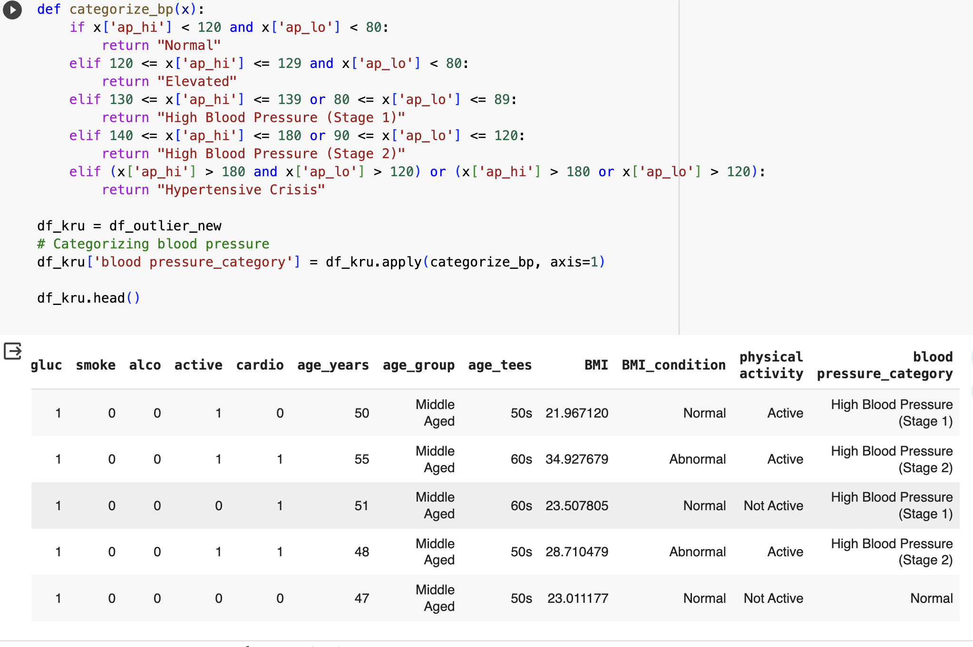
Categorizing the blood pressure
https://www.heart.org/en/health-topics/high-blood-pressure

Slide 32
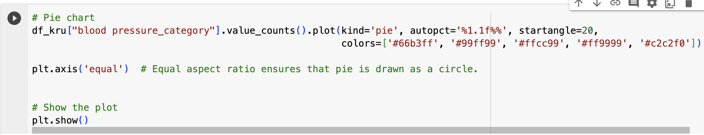
CATEGORIZATION OF BLOOD PRESSURE
df_kru["blood pressure_category"].value_counts().plot(kind='pie', autopct='%1.1f%%', startangle=20, colors=['#66b3ff', '#99ff99', '#ffcc99', '#ff9999', '#c2c2f0']): Creates a pie chart using the value_counts() function to count the occurrences of each unique value in the 'blood pressure_category' column. The autopct='%1.1f%%' displays percentage labels on each wedge, and startangle=20 sets the initial angle of the chart. Custom colors are defined for different categories.
plt.axis('equal'): Ensures an equal aspect ratio, making sure the pie chart is drawn as a circle.
plt.show(): Displays the generated pie chart.

Slide 33
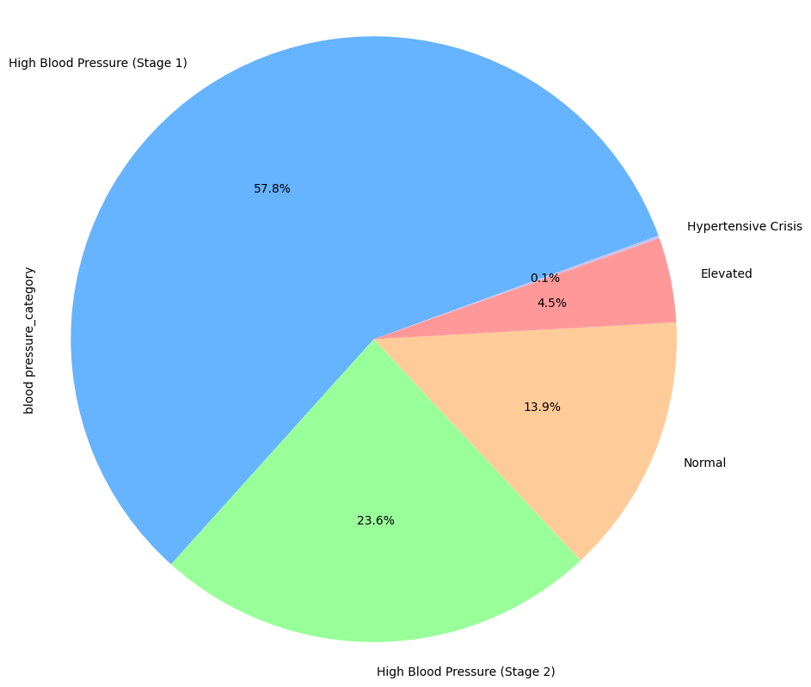
PIE CHART
The provided code generates a pie chart to visually represent the distribution of blood pressure categories in the DataFrame df_kru. The chart utilizes custom colors, percentage labels, and an equal aspect ratio for clear visualization. Each wedge in the pie chart corresponds to a specific blood pressure category, with the size of the wedge indicating the proportion of that category in the dataset

Slide 34
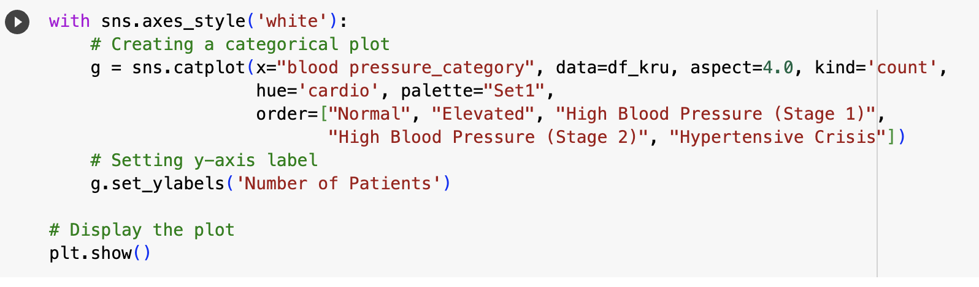
with sns.axes_style('white'):: Sets a white background style for the plot, enhancing visual clarity.
g = sns.catplot(...): Creates a grouped bar chart (count plot) using Seaborn.
x="blood pressure_category": Represents blood pressure categories on the x-axis.
data=df_kru: Uses data from the DataFrame df_kru.
aspect=4.0: Adjusts the aspect ratio for better visualization.
kind='count': Specifies a count plot.
hue='cardio': Colors segments based on the presence or absence of cardiovascular disease.
palette="Set1": Chooses a color palette for the plot.
order=["Normal", "Elevated", ...]: Defines the order of blood pressure categories on the x-axis.
g.set_ylabels('Number of Patients'): Adds a y-axis label indicating the count of patients.
plt.show(): Displays the created categorical plot

Slide 35
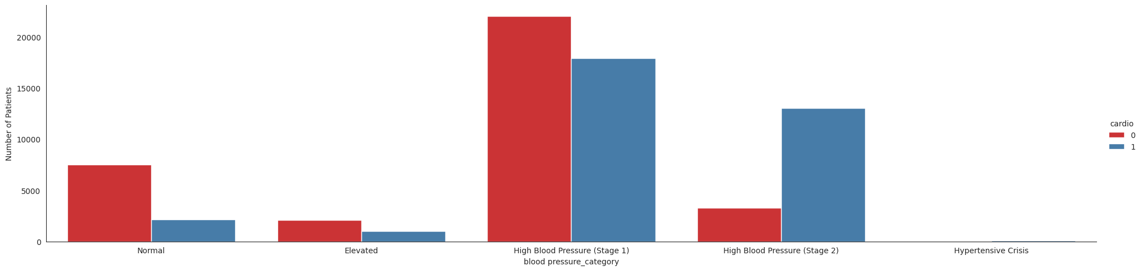
The resulting plot is a grouped bar chart where each bar represents the count of patients in different blood pressure categories, segmented by the presence or absence of cardiovascular disease

Slide 36
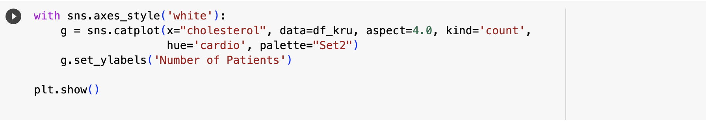
VISUALIZATION FOR CHOLESTROL
with sns.axes_style('white'):: Sets a white background style for the plot, improving visual clarity.
g = sns.catplot(...): Creates a grouped bar chart (count plot) using Seaborn.
x="cholesterol": Represents cholesterol levels on the x-axis.
data=df_kru: Utilizes data from the DataFrame df_kru.
aspect=4.0: Adjusts the aspect ratio for better visualization.
kind='count': Specifies a count plot.
hue='cardio': Colors segments based on the presence or absence of cardiovascular disease.
palette="Set2": Chooses a color palette for the plot.
g.set_ylabels('Number of Patients'): Adds a y-axis label indicating the count of patients.
plt.show(): Displays the created categorical plot

Slide 37
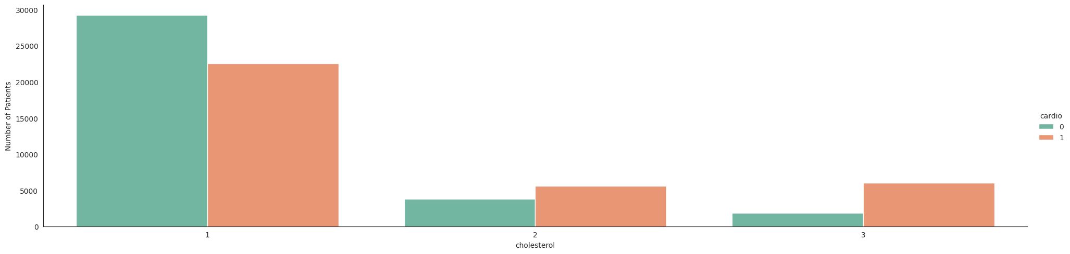
The resulting plot is a grouped bar chart where each bar represents the count of patients in different cholesterol levels, segmented by the presence or absence of cardiovascular disease.

Slide 38
CONCLUSION
The exploratory data analysis (EDA) conducted on the cardiovascular disease dataset revealed insightful patterns and correlations, particularly through visualizations such as bar charts, pie charts, donut charts. The identified relationships between age groups and cardiovascular disease presence showcased the potential of age as a significant factor in disease prevalence. The distinct patterns observed, where certain age groups exhibited higher rates of cardiovascular disease, provide valuable insights for further investigation and intervention strategies.
The EDA on BMI condition, cholesterol, and blood pressure underscores their significant associations with cardiovascular disease. Abnormal BMI, elevated cholesterol levels, and higher blood pressure contribute to increased cardiovascular risk. Monitoring these factors is crucial for preventive healthcare. Lifestyle interventions, regular screenings, and effective management are key in mitigating cardiovascular risks. Further research in these areas can enhance preventive strategies and improve overall cardiovascular health outcomes

